Slide 1

Introduction
to Web
Development

Slide 2
What is Web Development

Slide 3


Slide 4


Slide 5
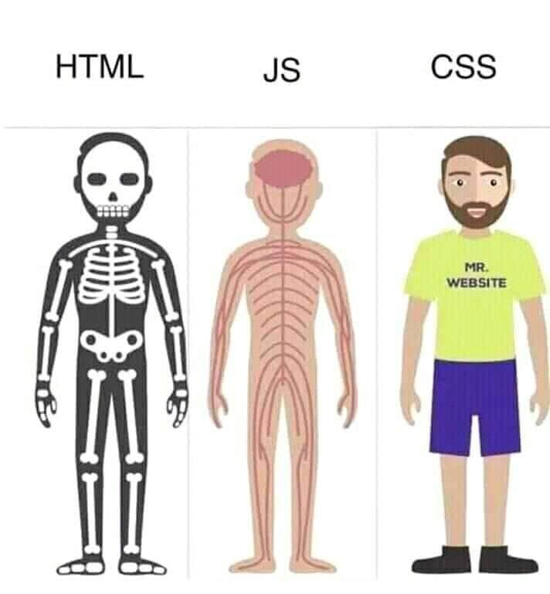
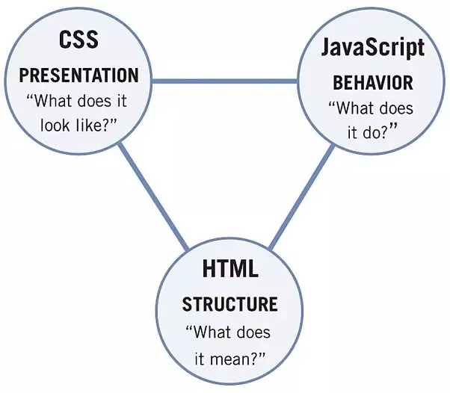

Slide 6

HTML
Hypertext Markup Language

Slide 7
Syntax
<tagname>
</tagname>

Slide 8
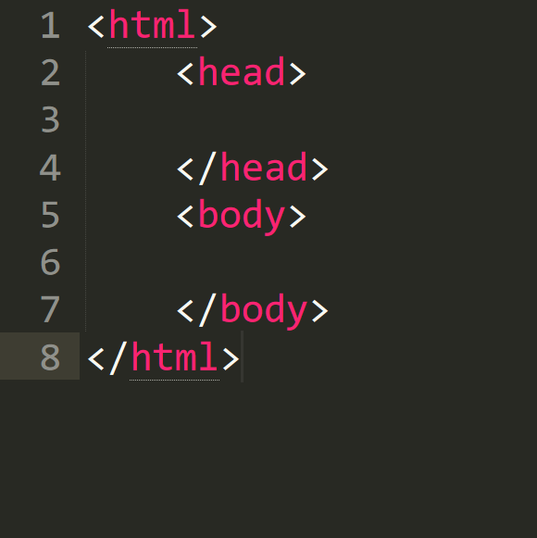
Syntax

Slide 9
<head> <title> Name of your page </title> </head>
<head> tags

Slide 10
<body> <h1> This is heading 1 </h1> <h2> This is heading 2 </h2> <h3> This is heading 3 </h3> <h4> This is heading 4 </h4> </body>
<body> tags

Slide 11
<img src=“images.jpg”> <a href=“https://www.google.com”> Whatever it takes </a>
<body> tags

Slide 12
<div> <p> <b> Welcome to Cyberlabs. </b> <i> Welcome to Cyberlabs. </i> <br> <u> Coding club of IIT (ISM), Dhanbad </u> </p> </div>
<body> tags

Slide 13
<div> <input type = “text”> </input> <button> “Click me” </button> </div>
<body> tags

Slide 14

CSS
Cascading Style Sheets

Slide 15
Syntax:
selector {
property-name: property-value;
}

Slide 16
<body> <h1 class=“header”> This is heading 1 </h1> <h2 class=“header” id=“my-id”> This is heading 2 </h2> <h3 class=“header”> </h3> <h4 class=“header”> </h4> </body>
Classes and IDs

Slide 17
color:
h1 {
color: red;
}

Slide 18
background-color:
h1{
background-color: green;
}

Slide 19
background-image:
body {
background-image: url(image.jpg);
background-size: cover;
}

Slide 20
font:
p {
font-family: “Times New Roman”, Times, serif;
font-style: italic;
font-size: 30px;
font-weight: bold;
}

Slide 21
Width and Height:
p {
height: 200px;
width: 50%;
}

Slide 22
border:
p {
border: 3px solid blue;
border-radius: 10px;
}

Slide 23

box-model:

Slide 24
padding:
p {
padding-top: 50px;
padding-right: 30px;
padding-bottom: 50px;
padding-left: 80px;
}
p {
padding: 50px 30px 50px 80px;
}

Slide 25
margin:
p {
margin-top: 50px;
margin-right: 30px;
margin-bottom: 50px;
margin-left: 80px;
}
p { margin: 50px 30px 50px 80px;
}

Slide 26
Thank you

